Slide 1

--Packia raj M
Oracle Basic SQL

Slide 2
ORACLE
+ Software Development Laboratories was founded in 1977.
+ In 1979 SDL changed its company name to Relational Software, Inc. (RSI) and introduced their product Oracle V2
+ In 1983, RSI was renamed Oracle Corporation
+ Oracle version 3 was released which had been re-written in the C Programming Language and supported commit and rollback transaction functionalities.
+ In 1984, Oracle version 4 was released which supported read consistency.
+ In 1985, Oracle 5 began supporting the Client-Server model
+ In 1988, Oracle version 6 was released with support for PL/SQL

Slide 3
+ In 1992, Oracle version 7 was released with support for integrity constraints, stored procedures and triggers.
+ In 1997, Oracle version 8 was released with support for object-oriented development and multimedia applications.
+ In 1999, Oracle 8i was released which is more in tune with the needs of the Internet. The database has a native Java Virtual Machine.
+ In 2001, Oracle 9i was released with 400 new features including the facility to read and write XML documents
+ In 2003, Oracle 10g was released. The g stands for "Grid"; one of the sales points of 10g is that it's "grid computing ready".

Slide 4
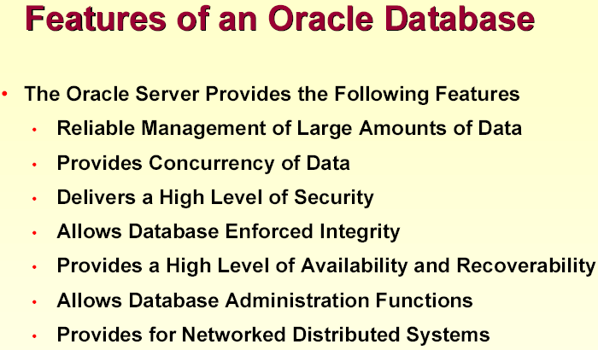

Slide 5
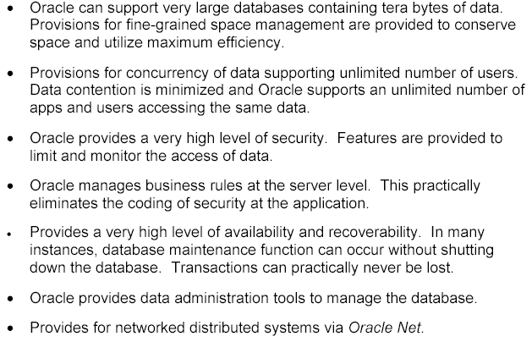

Slide 6
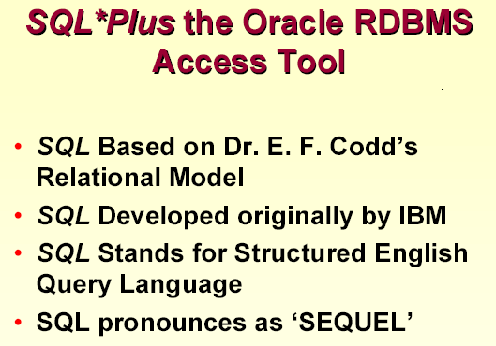

Slide 7
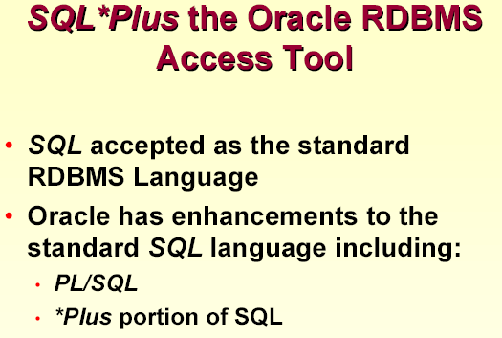

Slide 8
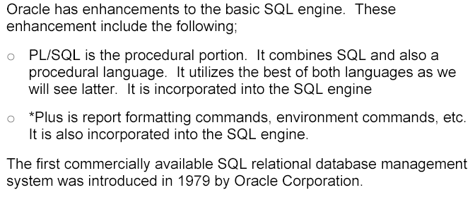

Slide 9
Introduction to Oracle SQL
Structured Query Language (SQL) is the set of statements with which all programs and users access data in an Oracle database.
Application programs and Oracle tools often allow users access to the database without using SQL directly, but these applications in turn must use SQL when executing the user’s request.
SQL can be used to access many relational databases including MS Access, and SQL-Server
SQL provides benefits for all types of uses, including application developers, database administrators, managers and end users.

Slide 10
SQL command Groups
Data Retrieval
DDL -data definition language
DML-data manipulation language
DCL- data control language
TCL- transaction control language

Slide 11
  Data Retrieval
  SELECT: used to retrieve the data present in the database tables

Slide 12
DDL commands
DDL -Data Definition Language
  CREATE: to create a new data structure.
  ALTER: to change an existing data structure.
  DROP: to remove an entire data structure.
  TRUNCATE : to remove all rows from table
  RENAME : to rename existing table

Slide 13
DML commands
DML-Data Manipulation Language
  INSERT: to add records into the table
  UPDATE: to change column value in the table
  DELETE: to remove rows from the table
  MERGE: to update & insert contents of one table to another table based on condition

Slide 14
DCL
DCL-Data Control Language
  GRANT :Allow access privileges to users (e.g. select, insert, update, alter, delete, etc to nominated tables or attribute in tables)
  REVOKE:Revoke or cancel access privileges

Slide 15
TCL
TCL-Transaction Control Language.
  COMMIT :Save or enable DML changes to the database.
  ROLLBACK: To undo DML changes till in a transaction
  SAVEPOINT: To divide a transaction

Slide 16
SELECT command query
Syntax : SELECT (column_list)
FROM (table_list )
WHERE (row restriction)
GROUP BY (attribute names)
HAVING (group restriction)
ORDER BY (attribute name or names)

Slide 17
*Topics to be covered
Tab table
Desc
Sql buffer
Arithmetic operators
Alias column name
Concatenate operator
Distinct
Nvl( )
Order by
Where clause
Logical operators
Sql operators
Substitution variables

Slide 18
Using - ESCAPE clause
SELECT * FROM EMP WHERE ENAME LIKE 'A\_B' ESCAPE '\'

Slide 19
DUAL table
DUAL is a DUMMY table
DUAL belongs to user SYS
SELECTing from the DUAL table is useful for computing a constant expression with the SELECT command.
Since DUAL has only one row, the constant is returned only once. Mainly used to return values for pseudocolumn, constant, expression etc.

Slide 20
Functions
Functions are used to manipulate data items. They accept one or more arguments and return one value.
Syntax: function_name(arg1,arg2,....)
Functions perform: calculation, modification, alter date formats, convert column datatypes

Slide 21
Types of functions
CHARACTER
NUMBER
DATE
CONVERTION
GROUP
FUNCTIONS THAT ACCEPT ANY DATA TYPE AS INPUT

Slide 22
CHARACTER functions
LOWER ( )
UPPER( )
INITCAP( )
CONCAT( )
LPAD( )
RPAD( )
SUBSTR( )
INITSTR( )
LTRIM( )
RTRIM( )
LENGTH( )
TRANSLATE( )
REPLACE( )

Slide 23
CHARACTER functions
LOWER ( )
UPPER( )
INITCAP( )
CONCAT( )
SQL> SELECT ENAME,LOWER(ENAME),UPPER('OrACle'),
INITCAP(JOB),CONCAT(JOB,SAL) FROM EMP WHERE
DEPTNO=10;
CLARK clark ORACLE Manager MANAGER2450
KING king ORACLE President PRESIDENT5000
MILLER miller ORACLE Clerk CLERK1300

Slide 24
LPAD( )
RPAD( )
SQL> SELECT DNAME,LPAD(DNAME,15,'.'),
RPAD(DNAME,15,'*') FROM DEPT;
ACCOUNTING .....ACCOUNTING ACCOUNTING*****
RESEARCH .......RESEARCH RESEARCH*******
SALES ..........SALES SALES**********
OPERATIONS .....OPERATIONS OPERATIONS*****

Slide 25
SUBSTR( )
INSTR( )
SQL> SELECT DNAME,SUBSTR(DNAME,3,4),SUBSTR(DNAME,4),
INSTR(DNAME,'C',1),INSTR(DNAME,'C',1,2)
FROM DEPT;
ACCOUNTING COUN OUNTING 2 3
RESEARCH SEAR EARCH 7 0
SALES LES ES 0 0
OPERATIONS ERAT RATIONS 0 0

Slide 26
LTRIM( )
RTRIM( )
SQL> SELECT DNAME,LTRIM(DNAME,'ASOP'),
RTRIM(DNAME,'NGES') FROM DEPT;
ACCOUNTING CCOUNTING ACCOUNTI
RESEARCH RESEARCH RESEARCH
SALES LES SAL
OPERATIONS ERATIONS OPERATIO

Slide 27
LENGTH( )
TRANSLATE( )
SQL> SELECT DNAME,LENGTH(DNAME),
TRANSLATE(DNAME,'A','X'),
TRANSLATE(DNAME,'AS','XY')FROM DEPT;
ACCOUNTING 10 XCCOUNTING XCCOUNTING
RESEARCH 8 RESEXRCH REYEXRCH
SALES 5 SXLES YXLEY
OPERATIONS 10 OPERXTIONS OPERXTIONY

Slide 28
REPLACE( )
SQL> SELECT
JOB,REPLACE(JOB,'SALESMAN','MARKETING')
FROM EMP WHERE DEPTNO=30;
SALESMAN MARKETING
SALESMAN MARKETING
SALESMAN MARKETING
MANAGER MANAGER
SALESMAN MARKETING
CLERK CLERK

Slide 29
CHR( )
SELECT CHR(67)||CHR(65)||CHR(84) "Dog" FROM DUAL;
CHARTOROWID( )
SELECT ENAME FROM EMP WHERE ROWID = CHARTOROWID('AAAHW7AABAAAMUiAAM');
COALESCE-COALESCE (expr1, expr2)
COALESCE returns the first non-null expr in the expression list. At least one expr must not be the literal NULL. If all occurrences of expr evaluate to null, then the function returns null.
It is equivalent to:
CASE WHEN expr1 IS NOT NULL THEN expr1 ELSE expr2 END

Slide 30
SELECT empno,ename,job,sal,comm, COALESCE(1.5*comm,sal,1000) “bonus” FROM emp;
Bonus will be 1.5 times of comm, if comm is null, bonus will be sal, if sal is null, bonus will be 1000
TRIM( )
SELECT TRIM (0 FROM 0009872348900) FROM DUAL;
98723489

Slide 31
NUMBER functions
ROUND( )
TRUNC( )
CEIL( )
FLOOR( )
POWER()
SQRT( )
SIGN( )
MOD( )
ABS( )

Slide 32
NUMBER functions
ROUND( )
SQL> SELECT ROUND(40.44,1), ROUND(40.45,1), ROUND(40.4),ROUND(40.5), ROUND(44.99,-1), ROUND(45.11,-1) FROM DUAL;
40.4 40.5 40 41 40 50
TRUNC( )
SQL> SELECT TRUNC(40.41,1),TRUNC(40.49,1), TRUNC(40.1),TRUNC(40.9),TRUNC(41.11,-1), TRUNC(49.99,-1)FROM DUAL
40.4 40.4 40 40 40 40

Slide 33
CEIL( ) FLOOR( )
SQL> SELECT CEIL(99.6),CEIL(-11.5),FLOOR(101.76),
FLOOR(-11.1) FROM DUAL;
CEIL(99.6) CEIL(-11.5) FLOOR(101.76) FLOOR(-11.1)
---------- ----------- ------------- ------------
100 -11 101 -12
POWER()
SQL> SELECT POWER(SAL,2),POWER(5,3) FROM EMP WHERE DEPTNO=10;
POWER(SAL,2) POWER(5,3)
------------ ----------
6002500 125
25000000 125
1690000 125

Slide 34
SQRT( )
SQL> SELECT SQRT(SAL),SQRT(25) FROM EMP WHERE DEPTNO=10;
SQRT(SAL) SQRT(25)
---------- ----------
49.4974747 5
70.7106781 5
36.0555128 5
SIGN( )
SQL> SELECT SAL-COMM,SIGN(SAL-COMM),
COMM-SAL,SIGN(COMM-SAL),SIGN(5-5)
FROM EMP WHERE DEPTNO=30;
1300 1 -1300 -1 0
750 1 -750 -1 0
-150 -1 150 1 0

Slide 35
MOD( ) ABS( )
SQL> SELECT MOD(10,3),MOD(10,2),ABS(45),ABS(-45) FROM DUAL;
MOD(10,3) MOD(10,2) ABS(45) ABS(-45)
---------- ---------- ---------- ----------
1 0 45 45
ASCII( )
SQL> SELECT ASCII(‘K’)”Ascii value” FROM DUAL;
Ascii value
-----------
75

Slide 36
DATE functions
Oracle stores dates in an internal numeric format representing:
Century Year Month Day Hours Minutes Seconds
Default format is “DD-MON-YY” or “DD-MON-YYYY”
Date functions operate on values of the DATE datatype. All date functions return a value of DATE datatype, except MONTHS_BETWEEN ( ) which returns a number.

Slide 37
To display system date
Sysdate( )
SQL> SELECT SYSDATE FROM DUAL;
SYSDATE
---------
17-OCT-98

Slide 38
Performing Arithmetic operations
SQL> SELECT HIREDATE,HIREDATE+7,
HIREDATE-7,SYSDATE-HIREDATE
FROM EMP WHERE DEPTNO=10;
09-JUN-81 16-JUN-81 02-JUN-81 6339.71453
17-NOV-81 24-NOV-81 10-NOV-81 6178.71453
23-JAN-82 30-JAN-82 16-JAN-82 6111.71453

Slide 39
MONTHS_BETWEEN( )
SQL> SELECT MONTHS_BETWEEN(SYSDATE,HIREDATE),
2 MONTHS_BETWEEN('01-JAN-1984','15-JAN-1998')
3 FROM EMP WHERE DEPTNO=10;
MONTHS_BETWEEN(SYSDATE,HIREDATE) MONTHS_BETWEEN('01-JAN-1984','15-JAN-1998')
-------------------------------- -------------------------------------------
208.281143 -168.45161
203 -168.45161
200.82953 -168.45161

Slide 40
ADD_MONTHS( )
SQL> SELECT HIREDATE,ADD_MONTHS(HIREDATE,3),
ADD_MONTHS(HIREDATE,-3)FROM EMP
WHERE DEPTNO=10;
HIREDATE ADD_MONTH ADD_MONTH
--------- --------- ---------
09-JUN-81 09-SEP-81 09-MAR-81
17-NOV-81 17-FEB-82 17-AUG-81
23-JAN-82 23-APR-82 23-OCT-81

Slide 41
NEXT_DAY( )
SQL> SELECT HIREDATE,NEXT_DAY(HIREDATE,'FRIDAY'),
NEXT_DAY(SYSDATE,'FRIDAY'),
NEXT_DAY(SYSDATE,6) FROM EMP
WHERE DEPTNO=10;
HIREDATE NEXT_DAY( NEXT_DAY( NEXT_DAY(
--------- --------- --------- ---------
09-JUN-81 12-JUN-81 23-OCT-98 23-OCT-98
17-NOV-81 20-NOV-81 23-OCT-98 23-OCT-98
23-JAN-82 29-JAN-82 23-OCT-98 23-OCT-98

Slide 42
LAST_DAY( )
SQL> SELECT HIREDATE,LAST_DAY(HIREDATE),
LAST_DAY(SYSDATE),LAST_DAY('12-FEB-88')
FROM EMP WHERE DEPTNO=10;
HIREDATE LAST_DAY( LAST_DAY( LAST_DAY(
--------- --------- --------- ---------
09-JUN-81 30-JUN-81 31-OCT-98 29-FEB-88
17-NOV-81 30-NOV-81 31-OCT-98 29-FEB-88
23-JAN-82 31-JAN-82 31-OCT-98 29-FEB-88

Slide 43
ROUND( )
SQL> SELECT ROUND(SYSDATE),
ROUND(SYSDATE,'MONTH'),ROUND(SYSDATE,'YEAR') FROM DUAL;
18-OCT-98 01-NOV-98 01-JAN-99
TRUNC( )
SQL> SELECT TRUNC(SYSDATE),
TRUNC(SYSDATE,'MONTH'),TRUNC(SYSDATE,'YEAR') FROM DUAL;
17-OCT-98 01-OCT-98 01-JAN-98

Slide 44
CONVERSION functions
TO_NUMBER( )
SQL> SELECT EMPNO,ENAME,JOB,SAL FROM EMP
2 WHERE SAL > TO_NUMBER('3000');
7839 KING PRESIDENT 5000
TO_CHAR( ) - NUMBER to CHAR
SQL> SELECT,SAL,
TO_CHAR(SAL,’9,99,999.99’),
TO_CHAR(SAL,’$9,99,999.99’) FROM EMP;
800 800.00 $800.00
1600 1,600.00 $1,600.00

Slide 45
TO_CHAR – DATE to CHAR
SQL> SELECT HIREDATE,
TO_CHAR(HIREDATE,'DAY,DDTH MONTH YEAR') FROM EMP;
17-DEC-80 WEDNESDAY,17TH DECEMBER NINETEEN EIGHTY
20-FEB-81 FRIDAY ,20TH FEBRUARY NINETEEN EIGHTY-ONE
SQL>SELECT HIREDATE,
TO_CHAR(HIREDATE,'FMDY,DDTH MON YYYY') FROM EMP;
17-DEC-80 WED,17TH DEC 1980
20-FEB-81 FRI,20TH FEB 1981
SQL>SELECT HIREDATE, TO_CHAR(HIREDATE,'DDD,DD/MM/YYYY HH:MI:SS') FROM EMP;
17-DEC-80 352,17/12/1980 12:00:00
20-FEB-81 051,20/02/1981 12:00:00

Slide 46
SQL>SELECT SYSDATE,TO_CHAR(SYSDATE,'DD/MM/YYYY HH24:MI:SSAM') FROM DUAL;
TO_DATE( )
SQL> SELECT ENAME,JOB,HIREDATE FROM EMP
2 WHERE HIREDATE=TO_DATE(&DATE,'DD/MM/YYYY');
old 2: WHERE HIREDATE=TO_DATE(&DATE,'DD/MM/YYYY')
new 2: WHERE HIREDATE=TO_DATE('3/12/1981','DD/MM/YYYY')
ENAME JOB HIREDATE
---------- --------- ---------
JAMES CLERK 03-DEC-81
FORD ANALYST 03-DEC-81

Slide 47
Function that accept any datatype as input - DECODE( )
SQL> SELECT ENAME,JOB,
2 DECODE(JOB,'MANAGER','Sr Manager',
3 'CLERK','Supervisor',
4 'ANALYST','Programmer',
5 'Unassigned') NEW_JOB FROM EMP;
ENAME JOB NEW_JOB
---------- --------- ----------
SMITH CLERK Supervisor
ALLEN SALESMAN Unassigned
WARD SALESMAN Unassigned
JONES MANAGER Sr Manager
MARTIN SALESMAN Unassigned
BLAKE MANAGER Sr Manager
CLARK MANAGER Sr Manager
SCOTT ANALYST Programmer

Slide 48
SQL> SELECT JOB,SAL,
DECODE(JOB,'MANAGER',SAL*1.25,
'CLERK',SAL*1.20,'SALESMAN',SAL*1.10,
SAL) DECODED_SAL FROM EMP;
JOB SAL DECODED_SAL
--------- ---------- -----------
CLERK 800 960
SALESMAN 1600 1760
SALESMAN 1250 1375
MANAGER 2975 3718.75
SALESMAN 1250 1375
MANAGER 2850 3562.5
MANAGER 2450 3062.5
ANALYST 3000 3000
PRESIDENT 5000 5000
SALESMAN 1500 1650
CLERK 1100 1320

Slide 49
GREATEST( )
SQL> SELECT GREATEST(10,20), GREATEST('ANAND','RAJESH') FROM DUAL
20 RAJESH
LEAST( )
SQL>SELECT LEAST(10,20),LEAST('ANAND','RAJESH') FROM DUAL
10 ANAND

Slide 50
GROUP functions
Group functions operate on sets of rows to give one result per group. Group functions ignore null values in the column.
MIN( ), MAX( ), AVG( ), SUM( ), COUNT( )
SQL> SELECT MIN(SAL),MAX(SAL),AVG(SAL),
SUM(SAL),COUNT(*)FROM EMP;
MIN(SAL) MAX(SAL) AVG(SAL) SUM(SAL) COUNT(*)
-------- ------- ---------- -------- ----- 800 5000 2073.21429 29025 14
SQL> SELECT MIN(SAL) FROM EMP WHERE JOB='CLERK';
MIN(SAL)
----------
800
SQL> SELECT COUNT(*) FROM EMP WHERE DEPTNO=30;
COUNT(*)
---------
6

Slide 51
GROUP BY clause
SQL> SELECT JOB,SUM(SAL) FROM EMP
2 GROUP BY JOB;
JOB SUM(SAL)
ANALYST 6000
CLERK 4150
MANAGER 8275
PRESIDENT 5000
SALESMAN 5600
SQL> SELECT DEPTNO,SUM(SAL) FROM EMP
2 WHERE DEPTNO != 10
3 GROUP BY DEPTNO;
DEPTNO SUM(SAL)
20 10875
30 9400

Slide 52
SQL> SELECT DEPTNO,JOB,SUM(SAL) FROM EMP
2 GROUP BY DEPTNO,JOB;
DEPTNO JOB SUM(SAL)
---------- --------- ----------
10 CLERK 1300
10 MANAGER 2450
10 PRESIDENT 5000
20 ANALYST 6000
20 CLERK 1900
20 MANAGER 2975
30 CLERK 950
30 MANAGER 2850
30 SALESMAN 5600

Slide 53
HAVING clause
SQL> SELECT DEPTNO,AVG(SAL) FROM EMP
2 WHERE COUNT(*) > 3
3 GROUP BY DEPTNO;
WHERE COUNT(*) > 3
*
ERROR at line 2:
ORA-00934: group function is not allowed here
SQL> SELECT DEPTNO,AVG(SAL) FROM EMP
2 HAVING COUNT(*) > 3
3 GROUP BY DEPTNO;
DEPTNO AVG(SAL)
---------- ----------
20 2175
30 1566.66667

Slide 54
To find the maximum sal of any department greater than 3000.
SQL> SELECT JOB,MAX(SAL) FROM EMP
2 GROUP BY JOB
3 HAVING MAX(SAL)>3000;
JOB MAX(SAL)
--------- ----------
PRESIDENT 5000

Slide 55
JOINING of Tables - Retrieving data from multiple tables
JOINS: JOINs are used to retrieve information from multiple tables.
TYPES OF JOINS:
1. EQUI-JOIN : JOINING of EMP and DEPT tables Using DEPTNO in WHERE clause.
2. NON-EQUI JOIN : JOINING of EMP and SALGRADE tables Using WHERE clause
3. OUTER JOIN
4. SELF JOIN

Slide 56
EQUI-JOIN
SQL> SELECT EMP.ENAME,EMP.JOB,EMP.DEPTNO,
DEPT.DNAME,DEPT.LOC
FROM EMP,DEPT
WHERE EMP.DEPTNO=DEPT.DEPTNO;
ENAME JOB DEPTNO DNAME LOC
SMITH CLERK 20 RESEARCH DALLAS
ALLEN SALESMAN 30 SALES CHICAGO
SQL> SELECT E.ENAME,E.JOB,E.DEPTNO,D.DNAME,D.LOC
2 FROM EMP E,DEPT D
3 WHERE E.DEPTNO=D.DEPTNO;
SQL> SELECT ENAME,JOB,E.DEPTNO,DNAME,LOC
2 FROM EMP E,DEPT D
3 WHERE E.DEPTNO=D.DEPTNO;

Slide 57
NON-EQUI JOIN
SQL> SELECT ENAME,JOB,SAL,GRADE
2 FROM EMP E,SALGRADE S
3 WHERE E.SAL BETWEEN S.LOSAL AND S.HISAL;
ENAME JOB SAL GRADE
---------- --------- ---------- ----------
SMITH CLERK 800 1
ADAMS CLERK 1100 1
JAMES CLERK 950 1
WARD SALESMAN 1250 2
MARTIN SALESMAN 1250 2
MILLER CLERK 1300 2
ALLEN SALESMAN 1600 3
TURNER SALESMAN 1500 3
JONES MANAGER 2975 4
BLAKE MANAGER 2850 4

Slide 58
JOINING of EMP,DEPT & SALGRADE tables
SQL> SELECT ENAME,SAL,E.DEPTNO,DNAME,LOC,GRADE
2 FROM EMP E,DEPT D,SALGRADE S
3 WHERE E.DEPTNO=D.DEPTNO AND
4 E.SAL BETWEEN S.LOSAL AND S.HISAL;
ENAME SAL DEPTNO DNAME LOC GRADE
SMITH 800 20 RESEARCH DALLAS 1
ADAMS 1100 20 RESEARCH DALLAS 1
JAMES 950 30 SALES CHICAGO 1
WARD 1250 30 SALES CHICAGO 2
MARTIN 1250 30 SALES CHICAGO 2

Slide 59
OUTER JOIN- operator “(+)”
Used for displaying missing data.
SQL> SELECT
ENAME,JOB,SAL,E.DEPTNO,D.DEPTNO,DNAME,LOC
FROM EMP E, DEPT D WHERE E.DEPTNO(+)=D.DEPTNO;

Slide 60
JOINING a table to IT-SELF
SQL> SELECT E.ENAME EMP_NAME,
2 M.ENAME MGR_NAME
3 FROM EMP E,EMP M
4 WHERE E.MGR=M.EMPNO;
EMP_NAME MGR_NAME
---------- ----------
SMITH FORD
ALLEN BLAKE
WARD BLAKE
JONES KING
MARTIN BLAKE
BLAKE KING
CLARK KING

Slide 61
SET Operators
SQL> SELECT JOB FROM EMP WHERE DEPTNO=10;
MANAGER
PRESIDENT
CLERK
SQL> SELECT JOB FROM EMP WHERE DEPTNO=20;
CLERK
MANAGER
ANALYST
CLERK
ANALYST

Slide 62
UNION operator
SQL> SELECT JOB FROM EMP WHERE DEPTNO=10
2 UNION
3 SELECT JOB FROM EMP WHERE DEPTNO=20;
ANALYST
CLERK
MANAGER
PRESIDENT

Slide 63
UNION ALL operator
SQL> SELECT JOB FROM EMP WHERE DEPTNO=10
2 UNION ALL
3 SELECT JOB FROM EMP WHERE DEPTNO=20;
JOB
---------
MANAGER
PRESIDENT
CLERK
CLERK
MANAGER
ANALYST
CLERK
ANALYST

Slide 64
INTERSECT operator
SQL> SELECT JOB FROM EMP WHERE DEPTNO=10
2 INTERSECT
3 SELECT JOB FROM EMP WHERE DEPTNO=20;
JOB
---------
CLERK
MANAGER
MINUS operator
SQL> SELECT JOB FROM EMP WHERE DEPTNO=10
2 MINUS
3 SELECT JOB FROM EMP WHERE DEPTNO=20;
JOB
---------
PRESIDENT

Slide 65
NESTED QUERIES (SUBQUERIES)
A SUBQUERY is a SELECT statement that is nested within another SELECT statement and which returns intermediate results
Syntax:
SELECT col1,col2,... FROM table_name
WHERE col_name=(SELECT col FROM table
WHERE condition)

Slide 66
Single row subqueries
Let us take an example
SQL> SELECT MIN(SAL) FROM EMP;
MIN(SAL)
----------
800
In the above case minimum sal is retrieved. Now let us try to retrieve the employee name who has this minimum salary.
SQL> SELECT ENAME,MIN(SAL) FROM EMP;
SELECT ENAME,MIN(SAL) FROM EMP
*
ERROR at line 1:
ORA-00937: not a single-group group function

Slide 67
SQL> SELECT ENAME,SAL FROM EMP
2 WHERE SAL=(SELECT MIN(SAL) FROM EMP);
ENAME SAL
---------- ----------
SMITH 800
Retrieve the employees who have the same job as that of BLAKE

Slide 68
SQL> SELECT ENAME,JOB
2 FROM EMP
3 WHERE JOB=(SELECT JOB FROM EMP WHERE ENAME='BLAKE');
ENAME JOB
---------- ---------
JONES MANAGER
BLAKE MANAGER
CLARK MANAGER
Find details of employees whose salary is greater than maximum salary of sales department.

Slide 69
SQL> SELECT ENAME,JOB,HIREDATE,SAL FROM EMP
2 WHERE SAL > (SELECT MAX(SAL) FROM EMP
3 WHERE DEPTNO=(SELECT DEPTNO FROM DEPT WHERE DNAME='SALES'));
ENAME JOB HIREDATE SAL
---------- --------- --------- ----------
JONES MANAGER 02-APR-81 2975
SCOTT ANALYST 19-APR-87 3000
KING PRESIDENT 17-NOV-81 5000
FORD ANALYST 03-DEC-81 3000
Subqueries returning multiple rows
Retrieve ename,salary,deptno of employees who draw minimum salary in each department.

Slide 70
SQL> SELECT ENAME,SAL,DEPTNO FROM EMP
2 WHERE SAL IN (SELECT MIN(SAL) FROM EMP GROUP BY DEPTNO);
ENAME SAL DEPTNO
---------- ---------- ----------
SMITH 800 20
JAMES 950 30
MILLER 1300 10
Query the department which has the avg(sal) greater to that of department 30.

Slide 71
SQL> SELECT DEPTNO,AVG(SAL) FROM EMP
2 HAVING AVG(SAL) > (SELECT AVG(SAL) FROM EMP
3 WHERE DEPTNO=30)
4 GROUP BY DEPTNO;
DEPTNO AVG(SAL)
---------- ----------
10 2916.66667
20 2175
Retrieve the maximum average salary for JOB

Slide 72
SQL> SELECT JOB,AVG(SAL)
2 FROM EMP GROUP BY JOB
3 HAVING AVG(SAL)=(SELECT MAX(AVG(SAL)) FROM EMP GROUP BY JOB);
JOB AVG(SAL)
--------- ----------
PRESIDENT 5000

Slide 73
CORRELATED subqueries
A correlated subquery cannot be evaluated as an independent query, but it can reference columns in a table listed in the FROM list of the outer query. The subquery is executed repeatedly once for each row that is selected by the outer query.
We can use a correlated subquery to find employees who earn salary greater than the average salary for their department.

Slide 74
SQL> SELECT EMPNO,ENAME,SAL,DEPTNO FROM EMP E
2 WHERE SAL > (SELECT AVG(SAL) FROM EMP WHERE DEPTNO=E.DEPTNO)
EMPNO ENAME SAL DEPTNO
---------- ---------- ---------- ----------
7499 ALLEN 1600 30
7566 JONES 2975 20
7698 BLAKE 2850 30
7788 SCOTT 3000 20
7839 KING 5000 10
7902 FORD 3000 20

Slide 75
Creating & Defining TABLE structures -DDL commands
When user creates a TABLE he can specify in which
TABLESPACE it has to be stored. If no
TABLESPACE is mentioned it is stored in USER
TABLESPACE by default.

Slide 76
Syntax:
CREATE TABLE [USER.]TABLE
( col1 datatype[(size)] [column constraint],
col2 datatype[(size)] [column constraint],
. . . . . .
. . . . . . ,
[Table constraint]
)
[TABLESPACE tablespace_name]

Slide 77
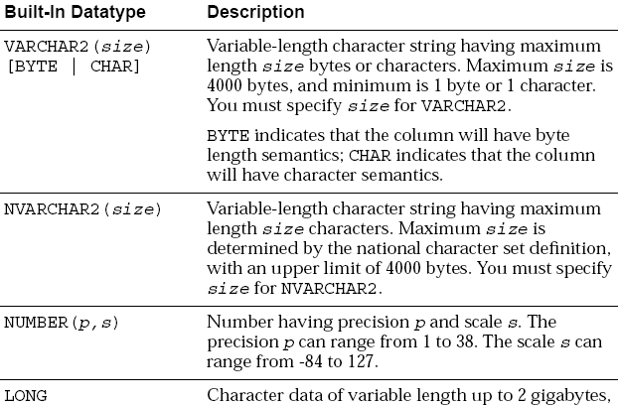

Slide 78
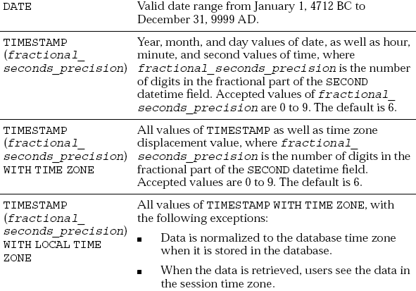

Slide 79
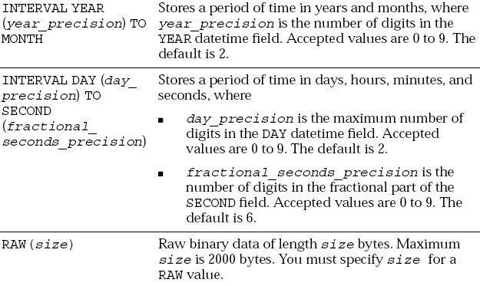

Slide 80
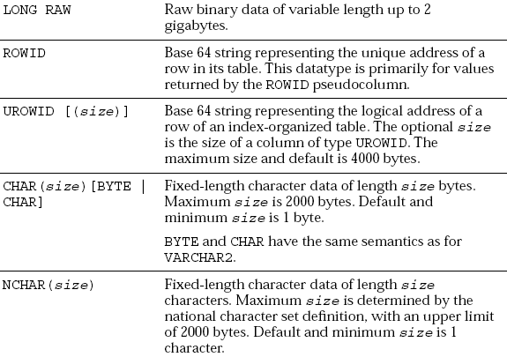

Slide 81
INTEGRITY CONSTRAINTS
It is a rule that restricts the values for one or more columns in a table.
Constraints are used :
To avoid invalid entry of data into table.
To enforce rules at table level whenever a row is inserted, updated or deleted from the table. The constraint must be satisfied for opertion to succeed.
To prevent the deletion of a table if there are dependencies from other tables.
Oracle allows user to define constraints at two levels.
1. Column level constraint : constraints are defined alongwith the column specification
2. Table level constraint :Constraints defined after defining all the column

Slide 82
Types of constraints
NOT NULL - Will not allow NULL values
CHECK- Checks for the given condition
Entity Integrity: Entity is data recorded in a database.
UNIQUE- Will not allow duplicate values. NULL’s are allowed
PRIMARY KEY- Will not allow duplicate values and NULL’s are not allowed
Referential Integrity:
FOREIGN KEY- A column value which is derived from PRIMARY KEY column of another table.

Slide 83
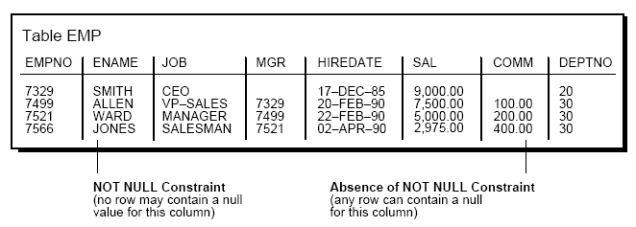
NOT NULL Integrity Constraints
By default, all columns can contain nulls.
Define NOT NULL constraints for columns of a table that absolutely require values at all times.

Slide 84
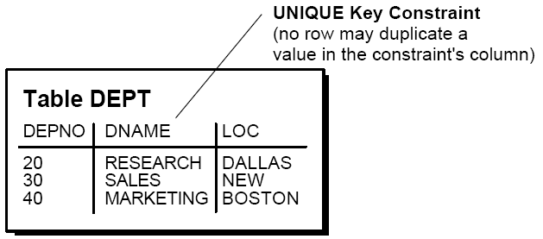
Use UNIQUE Key Integrity Constraints
Unique key constraints are appropriate for any column where duplicate values are not allowed.

Slide 85
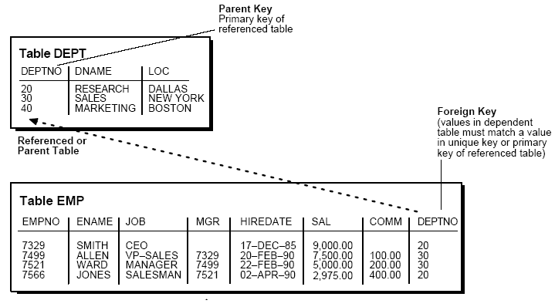
Primary Key
Each table can have one primary key, which uniquely identifies each row in a table and ensures that no duplicate rows exist.

Slide 86
Creating EMP and DEPT table with all the Constraints:
CREATE TABLE emp
(empno NUMBER(4) CONSTRAINT emp_pk PRIMARY KEY,
ename VARCHAR2(12) NOT NULL,
job VARCHAR2(15),
mgr NUMBER(4) CONSTRAINT ref_cons REFERENCES EMP(EMPNO),
hiredate DATE,
sal NUMBER(9,2) CONSTRAINT chk_sal CHECK(SAL<=5000),
comm NUMBER(6,2),
deptno NUMBER(2),
CONSTRAINT fk_dept_emp FOREIGN KEY (DEPTNO)
references DEPT(DEPTNO) [ON DELETE CASCADE]|[ON DELETE SET NULL]
);
or deptno number(2) references dept,

Slide 87
CREATE TABLE dept(
deptno NUMBER(2) CONSTRAINT dept_pk PRIMARY KEY,
dname VARCHAR2(12),
loc VARCHAR2(10),
CONSTRAINT dept_unq UNIQUE (dname,loc)
);
If “ON DELETE CASCADE” option is not used for EMP table and when we try to delete any department in which an employee is in is not permitted.
On using “ON DELETE CASCADE” all the corresponding employee records will be deleted automatically if any department is deleted in which an employee is in.

Slide 88
Set Foreign Keys to Null When Parent Key Deleted
When referenced data in the parent key is deleted, all rows in the child table that depend on those parent key values have their foreign keys set to null.
ON DELETE SET NULL option is used
Data Dictionary tables
USER_CONSTRAINTS
USER_CONS_COLUMNS
To display table structure:
SQL>DESC table_name;

Slide 89
Creating a table with rows from another table
Syntax:
CREATE TABLE table_name
[(column_name,....)]
as
SELECT statment.
Example:
SQL>CREATE TABLE dept30
as
SELECT EMPNO,ENAME,JOB,SAL FROM EMP WHERE DEPTNO=30;
SQL>SELECT * FROM dept30;

Slide 90
ALTERing a TABLE structure
ALTER TABLE table_name
[ADD/MODIFY/DROP](column_spec[column_constraint])[enable/
disable]
To add a column:
ALTER TABLE emp
ADD(second_name varchar2(12));
To add a CHECK constraint:
ALTER TABLE emp
ADD(CHECK(SAL <= 5000));
To add a primary key constraint:
ALTER TABLE emp
ADD(CONSTRAINT emp_prim PRIMARY KEY(EMPNO));
To add a Foreign key constraint:
ALTER TABLE emp
ADD CONSTRAINT fk_dept FOREIGN KEY(DEPTNO) REFERENCES DEPT(DEPTNO);

Slide 91
To MODIFY definition of an existing column:
To change the width of ENAME to 18 Characters:
ALTER TABLE emp
MODIFY(ename VARCHAR2(18));
Width cannot be decreased when values are existing.
To change NULL to NOT NULL
ALTER TABLE emp
MODIFY(job NOT NULL);
To DROP a constraint from the existing table.
To remove a constraint:
ALTER TABLE emp
DROP CONSTRAINT emp_prim;
ALTER TABLE table_name
DROP PRIMARY KEY;

Slide 92

ENABLE/DISABLE clause
ALTER TABLE emp
DISABLE CONSTRAINT dept_prim CASCADE;
CASCADE means that dependent constraints are also affected.
Removing a TABLE
DROP TABLE table_name;

Slide 93
RENAME command : To change the name of a database including TABLES, VIEEWS & SNONYMS
Syntax :
RENAME old TO new
Example :
SQL > RENAME emp TO employee;
When a table is renamed constraints are also copied to the new table.

Slide 94
Adding, Making changes and Deleting rows-DML commands
INSERTing new rows into a table:
Syntax:
INSERT INTO table_name[(col1,col2,...)]
VALUES (value1,value2,...);
Examples:
INSERT INTO dept VALUES(50,’MARKETING’,’SAN JOSE’);
Inserting to specific column
INSERT INTO dept (DEPTNO,LOC) VALUES(60,’LONDON’);

Slide 95
Inserting using substitution values:
INSERT INTO DEPT VALUES(&deptno,’&dname’,’&location’);
When the command is run, promps for data everytime.
INSERTing DATE and TIME information:
When inserting a DATE value, the format is DD-MON-YY(RR) is usually used. With this format year is < 50 it defaults to century 20. If >=50 it rounds to 19. The date also contains time information, which is not specified defaults to midnight (00:00:00)
If a DATE needs to be entered of another century along with time then TO_DATE function is to be used:
INSERT INTO emp VALUES(....,....,
TO_DATE(‘8/06/1996 10:45PM’,’DD/MM/YYYY HH:MIPM’,
.....,.....);

Slide 96
COPYING ROWS from another TABLE:
INSERT INTO TABLE[(col1,col2,.....)]
SELECT col1,col2,... FROM table [WHERE condition];
Changing values in a row-UPDATE
UPDATE table_name
SET col_name=value WHERE condition;
Example:
UPDATE EMP set JOB=‘SALESMAN’,HIREDATE=SYSDATE,
SAL=SAL*1.1 WHERE ENAME=‘SCOTT’;
If WHERE clause is omitted ALL the rows will be updated.

Slide 97
Removing rows from table - DELETE
Syntax:
DELETE [FROM] table_name
[WHERE condition];
DELETE EMP WHERE ENAME=‘SMITH’;
If WHERE clause is eliminated ALL the rows will be deleted.
TRUNCATE – To flush the contents of entire table

Slide 98
TRANSACTION’s - TCL commands
Transaction is an operation against the database which comprises a series of changes to one or more tables
There are two types of transactions:
DML transactions -consists of any no of DML statements which ORACLE treats as a single entity or logical unit of work.
DDL transactions - consists of only one DDL statment.
A transaction begins when the first executable DML or DDL statemnt is encountered and ends when one of the following occurs:
COMMIT/ROLLBACK
DDL command is used
LOGOFF
MACHINE FAILURE

Slide 99
Making changes permanent - COMMIT
COMMIT performs following when used:
makes changes in the current transaction permanent.
erases all save point in the transaction
ends the transaction
Once the changes are made it cannot be reverted.
Syntax:
COMMIT [WORK] or COMMIT;

Slide 100
UNDOING changes -ROLLBACK
ROLLBACK performs following when executed:
UNDOES the work done till previous save or SAVEPOINT
ends a transaction
erases all savepoints in current transaction if SAVEPOINT option is not used.
Syntax:
ROLLBACK [WORK] to [SAVEPOINT] savepoint_name

Slide 101
SAVEPOINT
Savepoints are used to divide a transaction into smaller portions.
Savepoints allow us to “hold” our work at any point of time and later committing or undoing all or portion of it.
AUTOCOMMIT: This option will commit changes immediately when DML statements are executed:
SQL>SET AUTOCOMMIT ON
..... ... ... ... ... ...
SQL>SET AUTOCOMMIT OFF

Slide 102
VIEWS
A view is like a “window” through which data on tables can be viewed or changed.
A view is derived from another table or view which is referred to as the base table of the view.
A view is stored as a select statement only. It is a virtual table- i.e a table that does not physically exist but appears to the user as if it exists.
A view has no data of its own. It manipulates data in the underlying base table.

Slide 103
Usefullness of VIEWS
Restricting access to the database. SELECTing from a view can display a restricted portion of database.
Allowing uses to make simple queries to retrive the results from complicated queries.
Types of views:
1. Simple views 2. Complex views
Simple views derive data from only one table. Contains no functions or groups of data.
Comples views are drived from multiples and also which contain functions or groups of data.

Slide 104
Syntax:
CREATE [OR REPLACE] [FORCE] VIEW view_name
[(col1,col2,col3,....)]
AS
SELECT statement
[WITH CHECK OPTION [CONSTRAINT constraint_name]]
Example: Simple view
SQL> CREATE VIEW DEPT10VIEW
2 AS
3 SELECT EMPNO,ENAME,SAL
4 FROM EMP
5 WHERE DEPTNO=10
6 WITH CHECK OPTION;
View created.
SQL> SELECT * FROM DEPT10VIEW;

Slide 105
Complex view:
SQL>CREATE VIEW DEPT_SUMMARY
2 (DEPTNAME,MINSAL,MAXSAL,AVGSAL)
3 AS
4 SELECT DNAME,MIN(SAL),MAX(SAL),AVG(SAL)
5 FROM EMP,DEPT
6 WHERE EMP.DEPTNO=DEPT.DEPTNO
7* GROUP BY DNAME;
View created.
SQL> SELECT * FROM DEPT_SUMMARY;
DEPTNAME MINSAL MAXSAL AVGSAL
-------------- ---------- ---------- ----------
ACCOUNTING 1300 5000 2916.66667
RESEARCH 800 3000 2175
SALES 950 2850 1566.66667

Slide 106
SQL> CREATE VIEW EMP_DEPT_SALGRADE(EMPNAME,DESIG,
2 SALARY,DEPTNO,DEPTNAME,LOCATION,GRADE)
3 AS
4 SELECT ENAME,JOB,SAL,E.DEPTNO,
5 DNAME,LOC,GRADE
6 FROM EMP E,DEPT D,SALGRADE S
7 WHERE E.DEPTNO=D.DEPTNO AND
8 E.SAL BETWEEN S.LOSAL AND S.HISAL;
View created.
SQL> SELECT * FROM EMP_DEPT_SALGRADE;
SMITH CLERK 800 20 RESEARCH DALLAS 1
ADAMS CLERK 1100 20 RESEARCH DALLAS 1

Slide 107
READ ONLY clause will not allow users to perform DML operations using views
CREATE VIEW MYVIEW
AS
SELECT * FROM DEPT
WITH READ ONLY;
Rule for DML Statements on Join Views
Any UPDATE, INSERT, or DELETE statement on a join view can modify only one underlying base table.

Slide 108
INLINE VIEWS
An inline view is not a schema object. It is a subquery with an alias (correlation name) that you can use like a view within a SQL statement.
SELECT D.DEPTNO,D.DNAME,SUM(E.SAL)
FROM DEPT D,(SELECT DEPTNO,SAL FROM EMP) E
WHERE E.DEPTNO=D.DEPTNO
GROUP BY D.DEPTNO,D.DNAME

Slide 109
Top ‘N’ Query
ROWNUM - pseudocolumn
Can be used to limit the number of rows returned by a query
SELECT Empno, Ename, Job, Mgr, Hiredate, Sal FROM Emp WHERE ROWNUM < 6;
If an ORDER BY clause follows ROWNUM in the same query, the rows will be reordered by the ORDER BY clause.
SELECT Empno, Ename, Job, Mgr, Hiredate, Sal FROM Emp WHERE ROWNUM < 6 ORDER BY Sal desc;
Because the ROWNUM is assigned upon retrieval, it is assigned prior to any sorting!

Slide 110
Solution:
In order to select employees with the highest five salaries, you have to force sorting and then apply ROWNUM condition.
Here is the syntax for a top-N query where N = 5
SELECT Empno, Ename, Job, Mgr, Hiredate, Sal
FROM
(SELECT Empno, Ename, Job, Mgr, Hiredate, Sal
FROM Emp
ORDER BY NVL(Sal, 0) DESC)
WHERE ROWNUM < 6;

Slide 111
Sequences
The sequence generator generates sequential numbers, which can help to generate unique primary keys automatically.
Sequences eliminate serialization (programmatically) and improve the concurrency of your application.
Creating sequences
CREATE SEQUENCE MYSEQ
START WITH 5
INCREMENT BY 1
MINVALUE 0
MAXVALUE 10
CYCLE
CACHE 5

Slide 112
The NOCYCLE option indicates that the sequence cannot generate more values after reaching its maximum or minimum value.
The CACHE option of the CREATE SEQUENCE command pre-allocates a set of sequence numbers and keeps them in memory so that they can be accessed faster. When the last of the sequence numbers in the cache have been used, another set of numbers is read into the cache.
Altering Sequences
ALTER SEQUENCE Emp_seq
INCREMENT BY 10
MAXVALUE 10000
CYCLE
CACHE 20;

Slide 113
Referencing a Sequence
Pseudocolumns NEXTVAL and CURRVAL are used
NEXTVAL -Each new sequence number is generated
CURRVAL-while the current sequence number can be repeatedly referenced.
NEXTVAL and CURRVAL can be used as pseudo-column names in SQL statements such as SELECTs, INSERTs, or UPDATEs.
*examples to be given
Dropping Sequences
DROP SEQUENCE sequence_name;

Slide 114
Synonyms
A synonym is an alias for a table, view, snapshot, sequence, procedure, function, package, or object type.
Synonyms let you refer to objects from other schemas without including the schema qualifier.
CREATE [PUBLIC] SYNONYM synonym_name FOR user.table;
Data dictionary table - user_synonyms
Dropping Synonyms
DROP SYNONYM synonym_name

Slide 115
DATABASE SECURITY
Privileges
A privilege is a right to execute a particular type of SQL statement or to access another user’s object.
Examples of privileges:
Connect to the database (create a session)
Create a table
Select rows from another user’s table
Execute another user’s stored procedure
There are two distinct categories of privileges:
1. System privileges 2. Schema object privileges

Slide 116
System Privileges
A system privilege is the right to perform a particular action.
For example, the privileges to create table spaces and to delete the rows of any table in a database are system privileges.
There are over 60 distinct system privileges.
Schema Object Privileges
A schema object privilege is a privilege or right to perform a particular action on a specific schema object:
Table
View
Sequence
Procedure
Function
Package

Slide 117
Roles
Roles are named groups of related privileges that you grant to users or other roles.
Roles are designed to ease the administration of end-user system and schema object privileges.
Predefined Roles
The following roles are defined automatically for Oracle databases:
CONNECT
RESOURCE
DBA
EXP_FULL_DATABASE
IMP_FULL_DATABASE

Slide 118
Indexes
Indexes are used in Oracle to provide quick access to rows in a table. Indexes provide faster access to data for operations that return a small portion of a table’s rows.
Guidelines
-Create an index if you frequently want to retrieve less than 15% of the rows in a large table.
-Index columns used for joins to improve performance on joins of multiple tables.
-Primary and unique keys automatically have indexes, but you might want to create an index on a foreign key
-Small tables do not require indexes.

Slide 119
Creating index
CREATE INDEX index_name ON table_name(col_name,col_name)
CREATE INDEX emp_ind ON emp(ename)
SELECT * FROM EMP WHERE ENAME='SMITH';
Dropping Index
DROP INDEX index_name;
Data dictionary table : user_indexes
Function-Based Indexes:
The following command allows faster case-insensitive searches in table EMP.
CREATE INDEX Idx ON Emp(UPPER(Ename));

Slide 120
Questions???

